Slide 1

The Relationship Between Bullying and Suicide:
What We Know and What it Means for Schools

Slide 2
What is Bullying?
Bullying is a repeated violent behaviour where one person (or group of people) intentionally intimidates, abuses, or forces an individual with the intention to hurt that person physically or emotionally.
Many young people can be unkind to each other during adolescence as they perfect social skills and grow into adults.
While these interactions are unpleasant, there is a clear line between conflict and bullying. Incidents of bullying must include all 3 of these characteristics:
Intentional:
the behaviour was aggressive
and a deliberate attempt to
hurt another person.
Repeated:
these aggressive actions occur repeatedly over time to the same person or group of people.
Power imbalance:
the person bullying has more physical or
social power than the child or children being bullied.

Slide 3
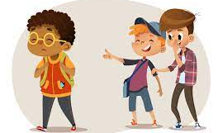
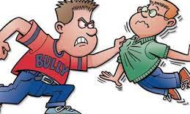

BULLYING

Slide 4

LET'S DO ROLE PLAY- HOW DO YOU UNDERSTAND BULLYING
Bullying almost always takes an emotional toll upon the child being bullied, but the actions that constitute bullying vary. There are four types of bullying:
Physical bullying such as kicking or pushing
Verbal bullying such as name-calling or yelling
Relational bullying such as excluding or rumor-spreading
Cyberbullying which involves sending hurtful messages over digital devices like computers and cell phones.

Slide 5
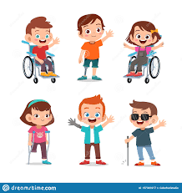
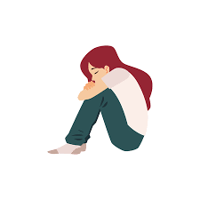

Who is at risk?
All young people are in danger of being bullied at some point during their adolescence—but there are certain populations at greater risk.
Depending on the environmentsome groups—such as youth who are perceived
SOCIALLY ISOLATED
LGBTQI
DISABLED

Slide 6
What are the results?
Youth who are bullied are more likely to suffer from the following:
Depression, anxiety, eating disorders, and thoughts of suicide
Health issues like headaches, sleep problems, abdominal pain, bed-wetting, and fatigue
Academic issues including poor attendance, low test scores, and increased dropout rates
Youth who bully:
Are at greater risk of smoking tobacco and drinking alcohol
Perform poorly in school and have a poor perception of school environment or life itself
Are more likely to become involved in criminal activity and to experience psychiatric disorders

Slide 7

How to cope with Bullying
AS A STUDENT:
The victim must know that fighting back will not solve the problem or make him/her feel better.
Remember you are not the problem, the bully is.
You have the right to feel safe and secure
Instead of ignoring the bully, tell him/her to stop and walk away.
Always tell an adult you can trust
If you find it difficult to say what happened, write it down on a paper and give it to an adult that you trust.
If you see someone being bullied, report it to the nearest adult.

Slide 8

AS A PARENT:
Do not ask, “why didn’t you defend yourself?”
Do not as your child to fight back
Do not tell him/her, “Don’t Worry”
Do not ask a lot of questions, but try to listen more.
Assure him/her that it is the bully that has the problem, not you.
Offer your child some options, if he’s confronted by the bully
If the bullying continues, talk to the school principal
Encourage your child to have a positive outlook
Encourage your child to make friends at school

Slide 9

AS TEACHERS:
Understand that parents are also under pressure
Get the full story from the victim, do not question him/her like an investigator
Explain that the school understands and will take action as soon as possible
Get ready to take immediate action if the victim is in danger
Explain the school’s policy on ballism
Avoid blaming the bully’s attitude, and emphasise the positive aspects of the bully

Slide 10
THANK YOU FOR BEING WITH US TODAY
NEED ANY HELP CONTACT YOU NEW BEST FRIEND BUDDY:
081 2828 917
OTHER NUMBERS TO CONTACT:
POLICE 10111
GBV 0800 428 428
NETCARE 911
EMS 10177
CHILDLINE 0800 555 55
SUICIDE 0800 567 567

